Slide 1
Basics of hydrogen embrittlement
Daniel Huang
Department of Mechanical Engineering
Aalto University

Slide 2
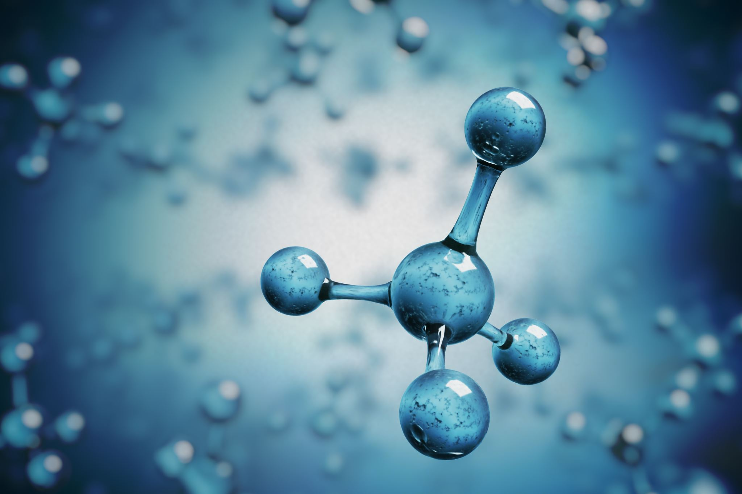
Content
Fick’s law
Aarhenius equation
Gibbs free energy
Solubility
Conclusion

Slide 3
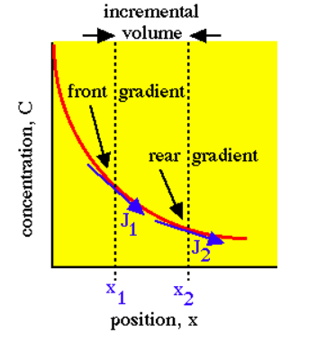
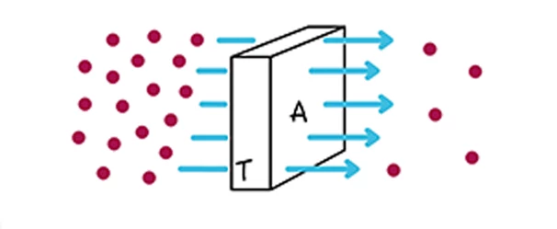
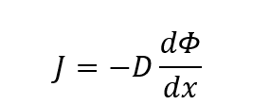



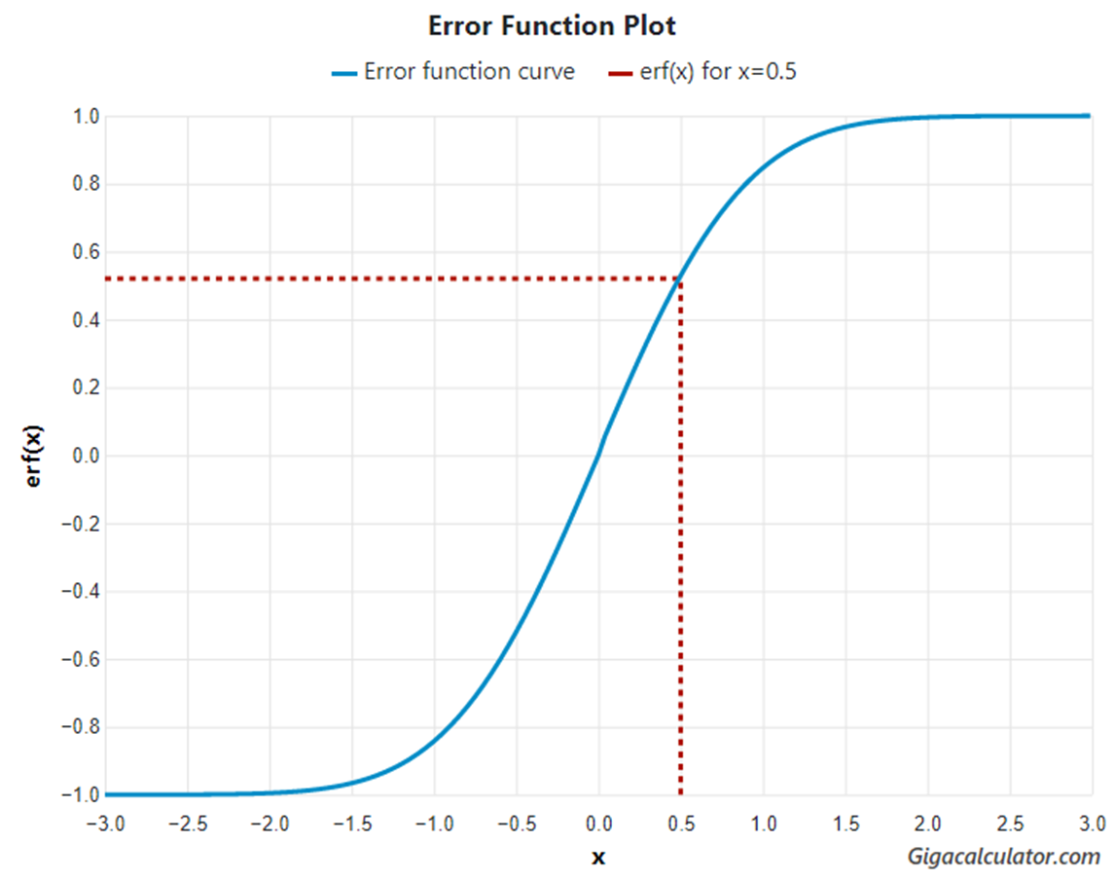



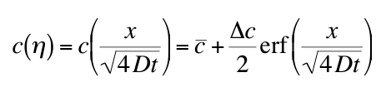
Fick’s Law
First Law(1D)
Moving Rate
Surface Area
Concentration Difference
Thickness
Second Law(1D)
Atom Parameter
Breaking Attempts
A high curvature in the concentration profile (i.e., where the concentration gradient is changing rapidly with respect to position) will see more rapid changes in concentration over time.

Slide 4

Calculation example
On one side of the membrane (side A), the gas concentration is 0.5 mol/m³, and on the other side (side B), it is 0.1 mol/m³. The membrane allows gas to pass through. What’s the initial flux of gas from side A to side B. The diffusion coefficient of gas in the solution is 1.5×10⁻⁹ m²/s, and the distance between the two sides is 0.01 m.

Slide 5



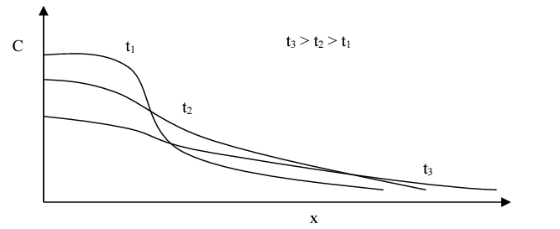
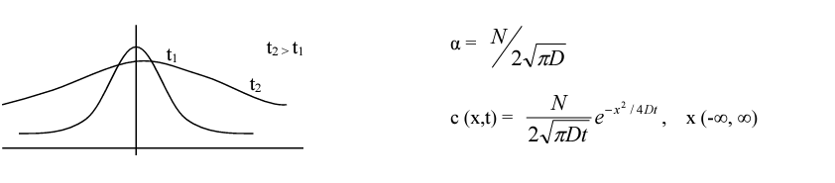
Calculation example
Consider a thin layer of B deposited onto A, through annealing at high temperature, we will be able to get the concentration profile at different times, from there then we can determine the diffusion coefficient, D

Slide 6

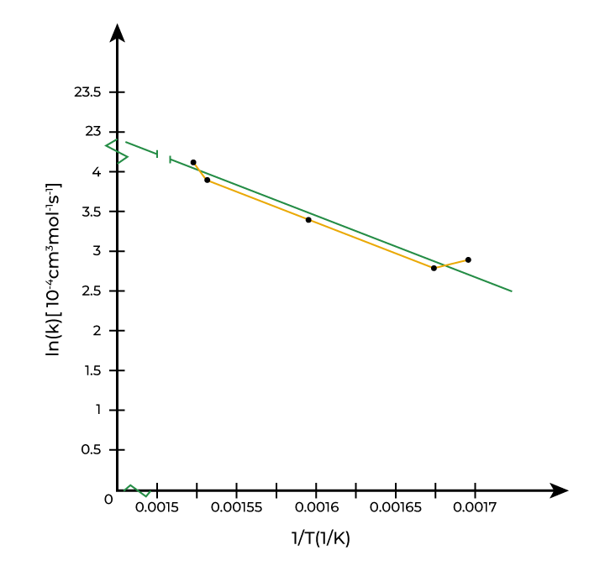
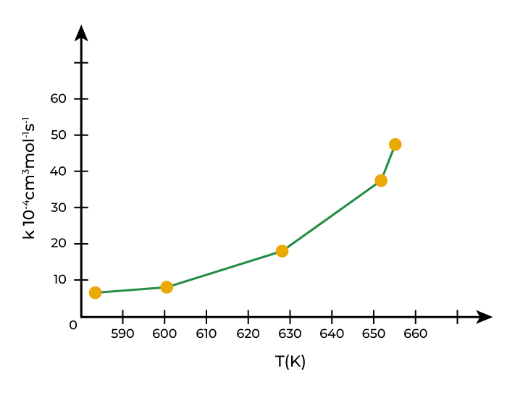





Arrhenius Equation
Temperature dependence of reaction rates in chemical reactions
Pre-exponential Factor
Reaction Energy (minimum)
$$k=Ae^{−\frac{E_{a}}{RT}}$$
Idea gas Constant
Temperature
Reaction Rate Constant
Average Kinetic Energy
Collision Frequency
$$A=PZ$$
Steric Factor
https://www.geeksforgeeks.org/arrhenius-equation/

Slide 7
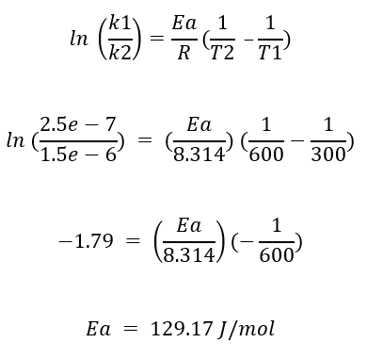
Calculation example
The rate constant of a chemical reaction is 2.5e-7 /Ms at 300K. The rate constant for this reaction is 1.5e-6 /Ms at 600K. Calculate the activation energy of the reaction.

Slide 8
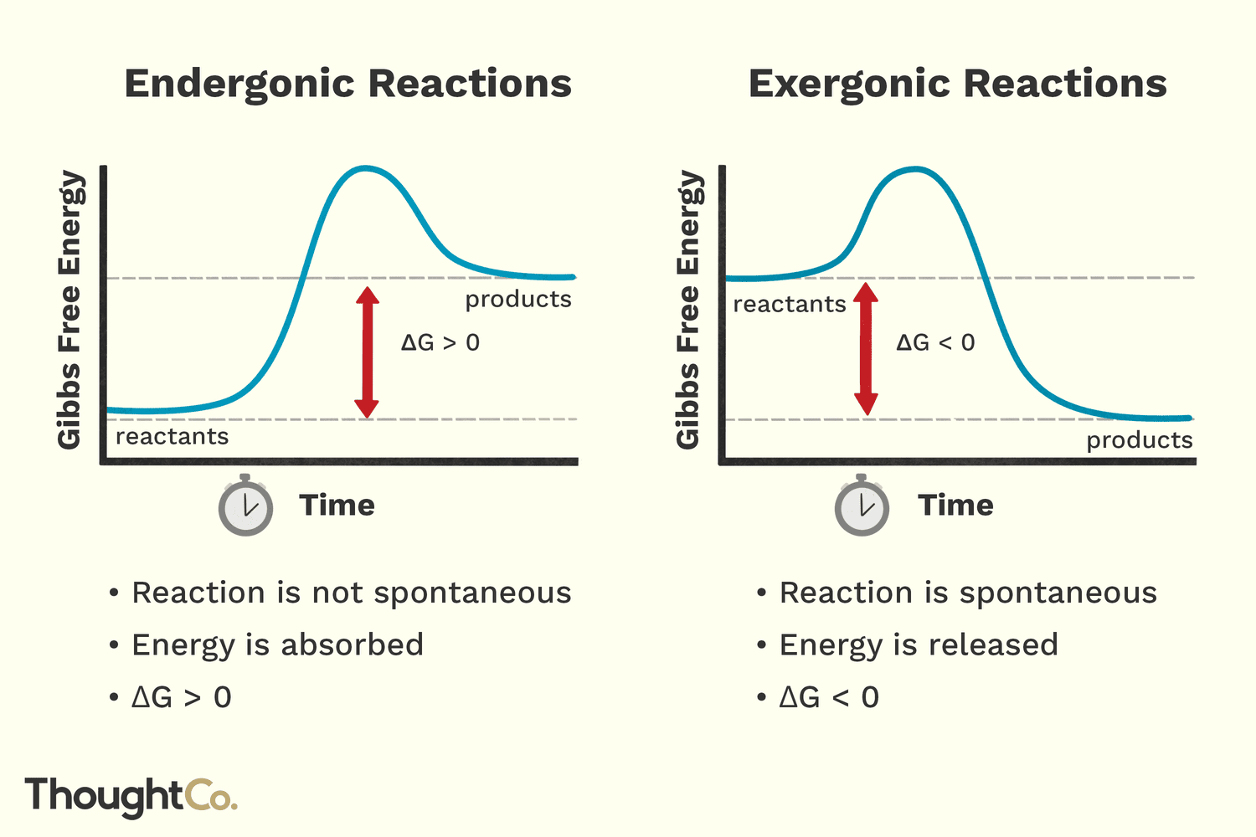
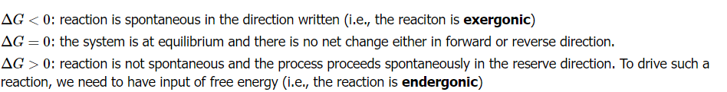



Gibbs free energy
Enthalpy
$$∆G=∆H−T∆S$$
Standard Gibbs Free Energy
Gibbs Free Energy
Entropy
$$∆G^{°}=−RT\left(lnK\right)=∆H^{°}−T∆S^{°}$$
Internal Energy
Pressure
Equilibrium Constant
$$∆G=U+PV−T∆S$$
The difference between the free energy of a substance and the free energies of its constituent elements at standard-state conditions:
Volume
Average Kinetic Energy
https://chem.libretexts.org/Bookshelves/Physical_and_Theoretical_Chemistry_Textbook_Maps/Supplemental_Modules_(Physical_and_Theoretical_Chemistry)/Thermodynamics/Energies_and_Potentials/Free_Energy/Gibbs_(Free)_Energy

Slide 9
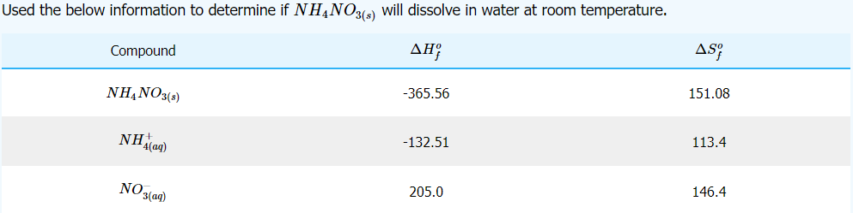
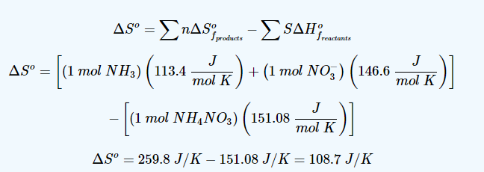
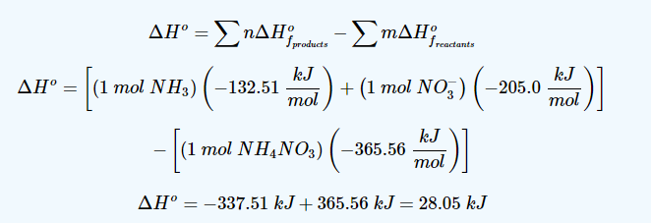
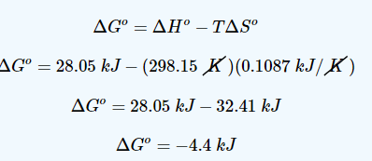
Calculation example

Slide 10
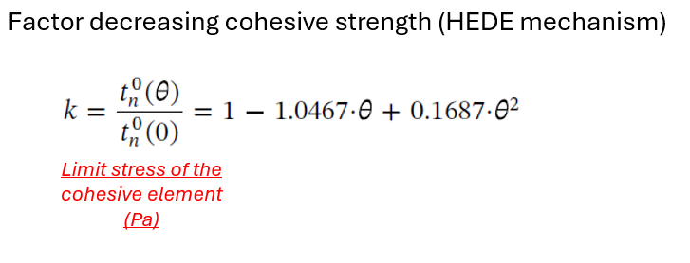
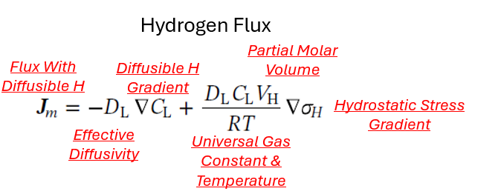
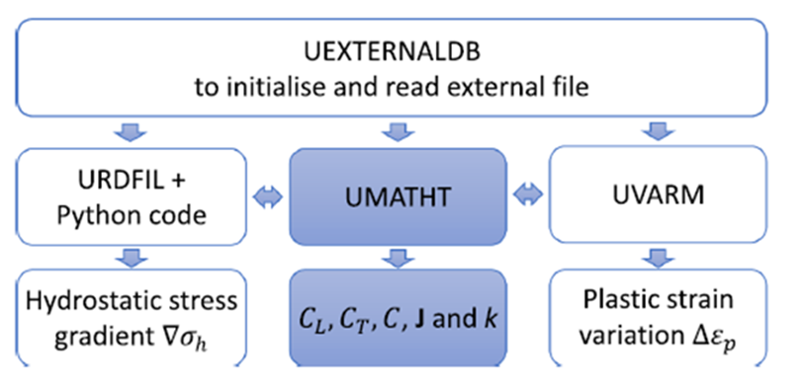
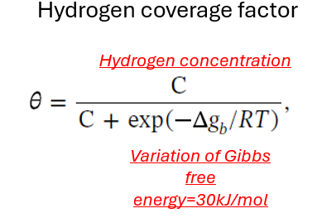
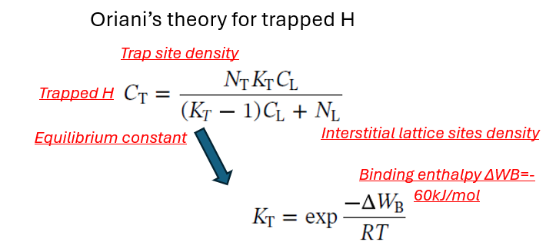


Connections
Ratio of the concentrations

Slide 11
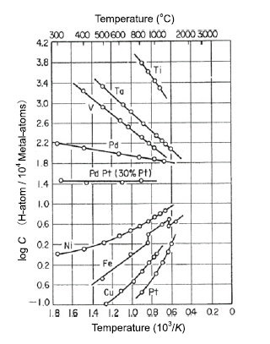
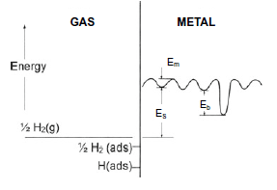
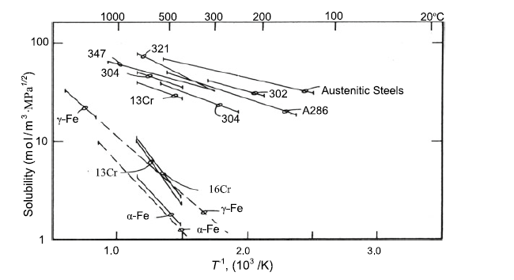
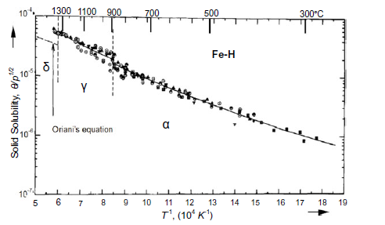
Solubility
Temperature
dependence of hydrogen
solubility in various metals
in equilibrium at 0.1 MPa
Solid solubility of hydrogen in iron above 573 K
Solid solubility data of hydrogen in stainless steel

Slide 12








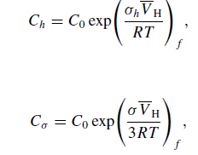


Absorption Theories
(The equilibrium reaction)
Standard State Energy
Chemical Equilibrium Energy
Concentration Activity
(Equal Energy at Equilibrium)
(Gibbs energy absorption of hydrogen)
Fugacity
Fugacity Coefficient
Hydrostatic Stress
Concentration under Hydrostatic Stress
Partial Mole Volume
Uniaxle Stress
Hydrostatic Stress

Slide 13
Conclusion
What’s:
Fick’s Law
Aarhenius Equation
Gibbs Free Energy
Solubility

Slide 14
Thanks

